Slide 1

Housekeeper Scheduling System

Slide 2
Group No: 5
Team Lead:- Nitish Vikas Tiwari
Group Members:-
Logesh Gangadharan
Mallappa X
Mangu Sahith Kumar
Mekala Lok Chandu
Moolinti Guru Prathap
Nelluri Bhanu Teja
Nikhil Singh
Pavithra M
Pradeepa Purushothaman

Slide 3
Abstract :
The main objective of HOUSEKEEPER SHEDULING SYSTEM is hostel students can use to get their rooms cleaned on time.
Admin will select a housekeeper and allots a housekeeper with a specific request coming from a student
Using this HOUSEKEEPER SHEDULING SYSTEM Admin can Add, Edit and Delete housekeeper details like name, hostel, floor, rooms_cleaned and complaints. Also, Enable or disable the housekeeper.
By using HOUSEKEEPER SHEDULING SYSTEM we can maintain the feedback and request status of the user.

Slide 4
Objective:
The function will automatically generate cleaning plans based on the number of rooms, number of staff and amount of time spent cleaning per room
The housekeeping department takes pride in keeping the hotel clean and comfortable so as to create a ‗home away from home'. Good housekeeping is considered as the backbone of accommodation sector as its main aim is to provide a clean comfortable, safe and aesthetically appealing environment.

Slide 5
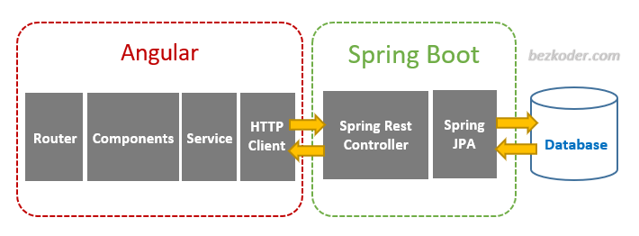
Project Architecture

Slide 6
Tools & Technologies Used
Front-End : Angular
Server-side : Spring Boot
Back-end : MYSQL, Hibernate
Server : Tomcat

Slide 7
HTML & CSS :
HTML (the Hypertext Markup Language) and CSS (Cascading Style Sheets) are two of the core technologies for building Web pages.
HTML provides the structure of the page, CSS the (visual and aural) layout, for a variety of devices.
Along with graphics and scripting, HTML and CSS are the basis of building Web pages and Web Applications.
HTML is the language for describing the structure of Web pages and CSS is the language for describing the presentation of Web pages, including colors, layout, and fonts

Slide 8
Angular :
Angular is a platform and framework for building single-page client applications using HTML and TypeScript.
Angular is written in TypeScript. It implements core and optional functionality as a set of TypeScript libraries that you import into your applications.
The architecture of an Angular application relies on certain fundamental concepts. The basic building blocks of the Angular framework are Angular components that are organized into NgModules.

Slide 9
MySQL:
MySQL is currently the most popular database management system software used for managing the relational database.
It is open-source database software, which is supported by Oracle Company.
It is fast, scalable, and easy to use database management system in comparison with Microsoft SQL Server and Oracle Database.
MySQL follows the working of Client-Server Architecture. This model is designed for the end-users called clients to access the resources from a central computer known as a server using network services.

Slide 10
Modules:
The system comprises of 2 major modules with their sub-modules as follows:
Admin:
Login: Admin can login his personal account.
Dashboard: Where all the details are displayed.
Allot: Admin can allot a housekeeper.
Complaints: Complaints which are raised by the user are displayed.
Suggestions: Suggestions which are given by the user are displayed.
Register Student: Admin can register a new student.
Register Housekeeper: Admin can register a new housekeeper.
Logout: Admin can logout after the completion of his work

Slide 11
User Module:
Login: User can login his personal account.
Dashboard: Where all the details are displayed.
Requests: User can request a housekeeper by selecting date and time.
Feedback: User gives the feedback like suggestions and complaints about the housekeeper performance.
Profile: Details of the User.
Logout: User can logout after the completion of his work.

Slide 12
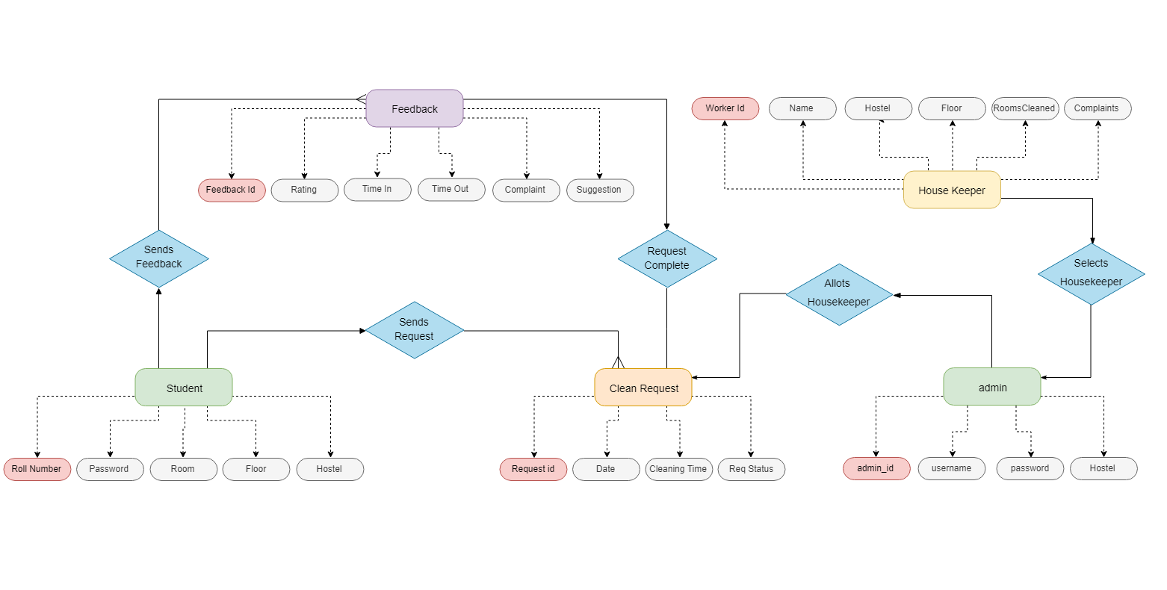
Class Diagram

Slide 13
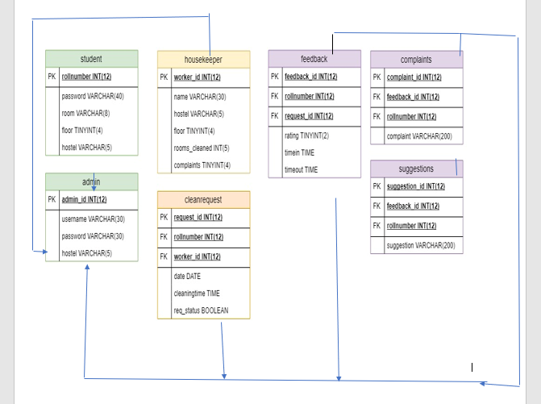
ER Diagram:

Slide 14
Advantages:
This system is very easy to understand and user friendly.
Student and Hostel Warden are connected with each other on one system.
This system is saving the time for student and hostel warden too.
In this system user can connect any time whenever he/she wants.
This system is secure.

Slide 15
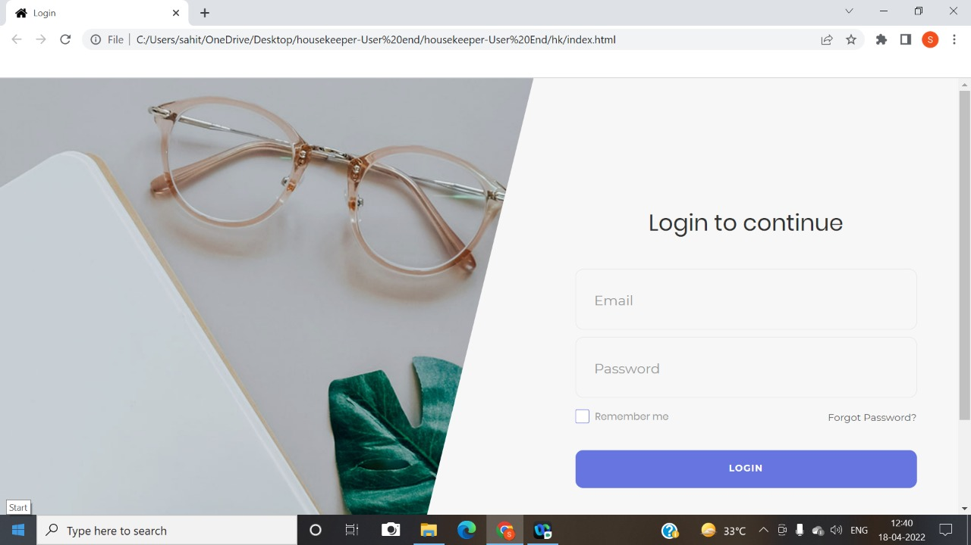
Screenshots:(Login page:)

Slide 16
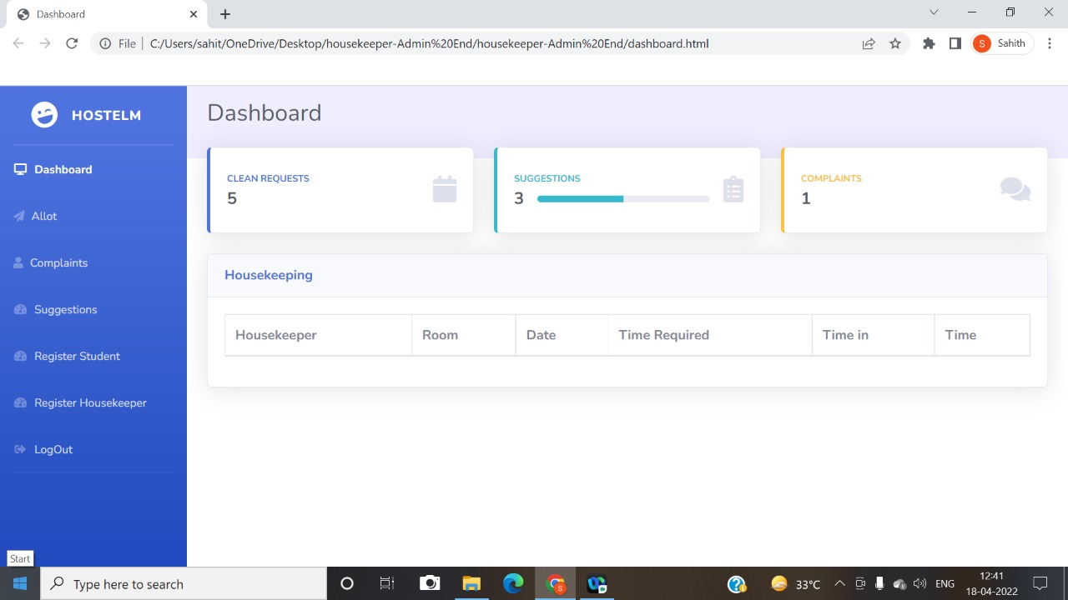
Admin Dashboard:

Slide 17
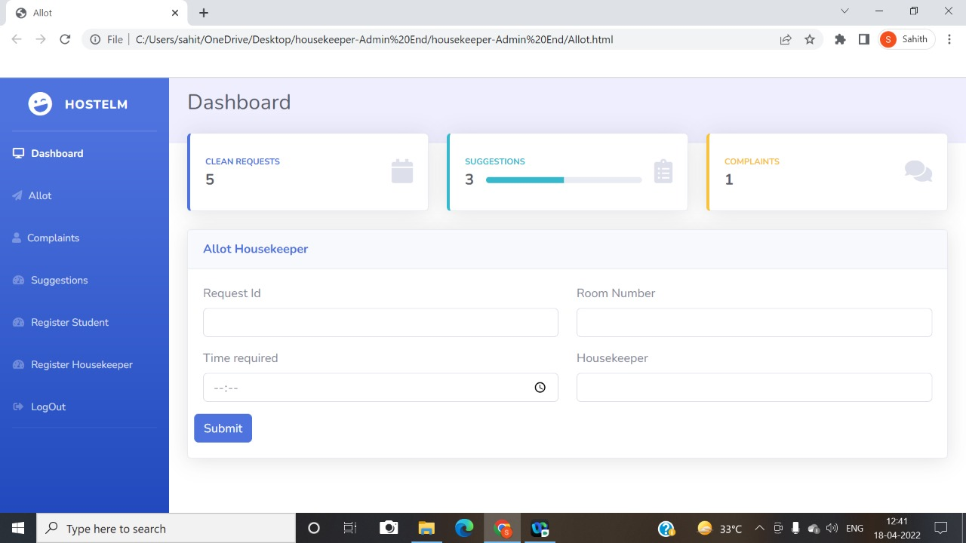
Allot Housekeeper:

Slide 18
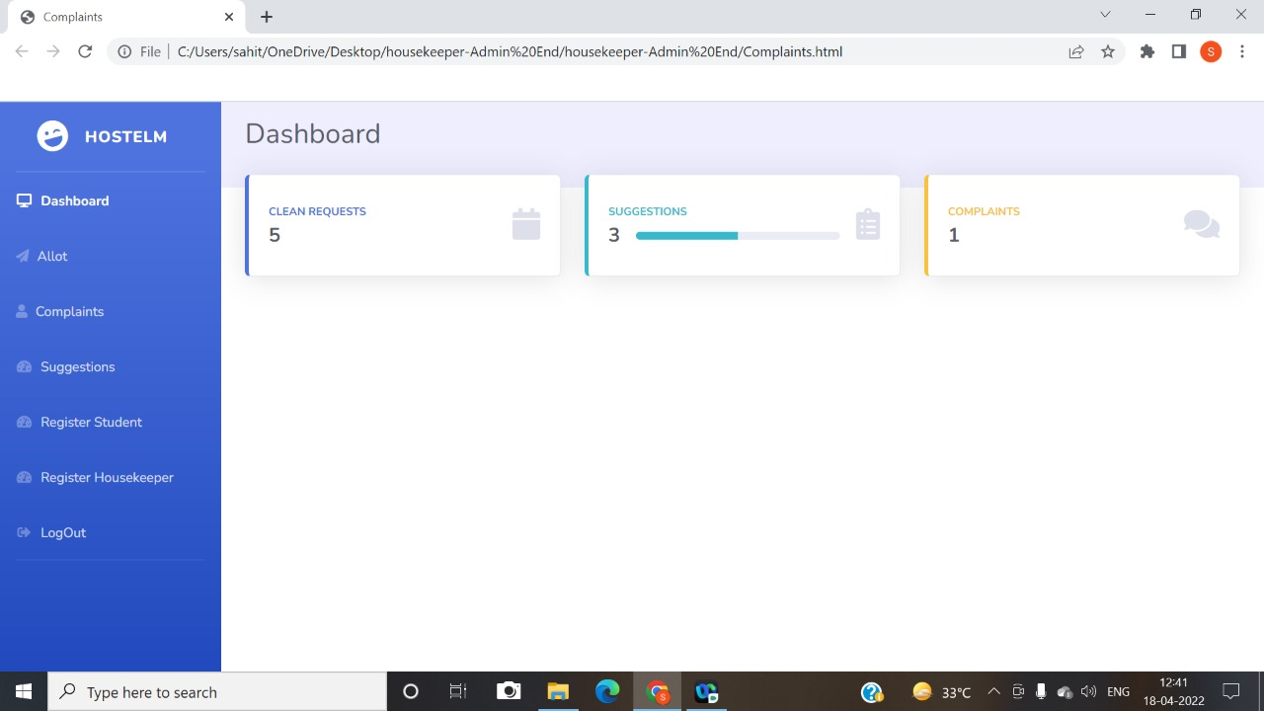
Complaints:

Slide 19

Suggestions:

Slide 20
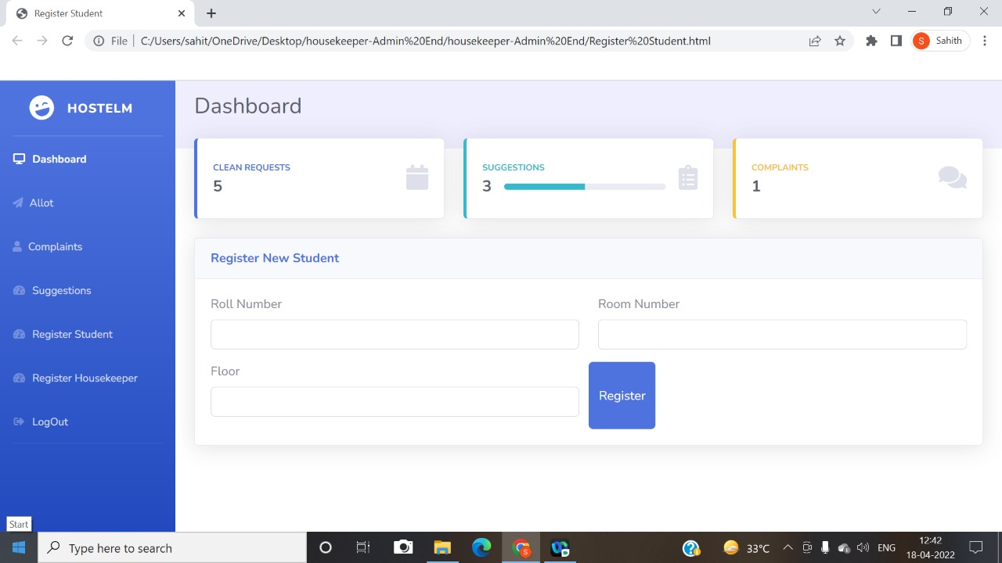
Register New Student:

Slide 21
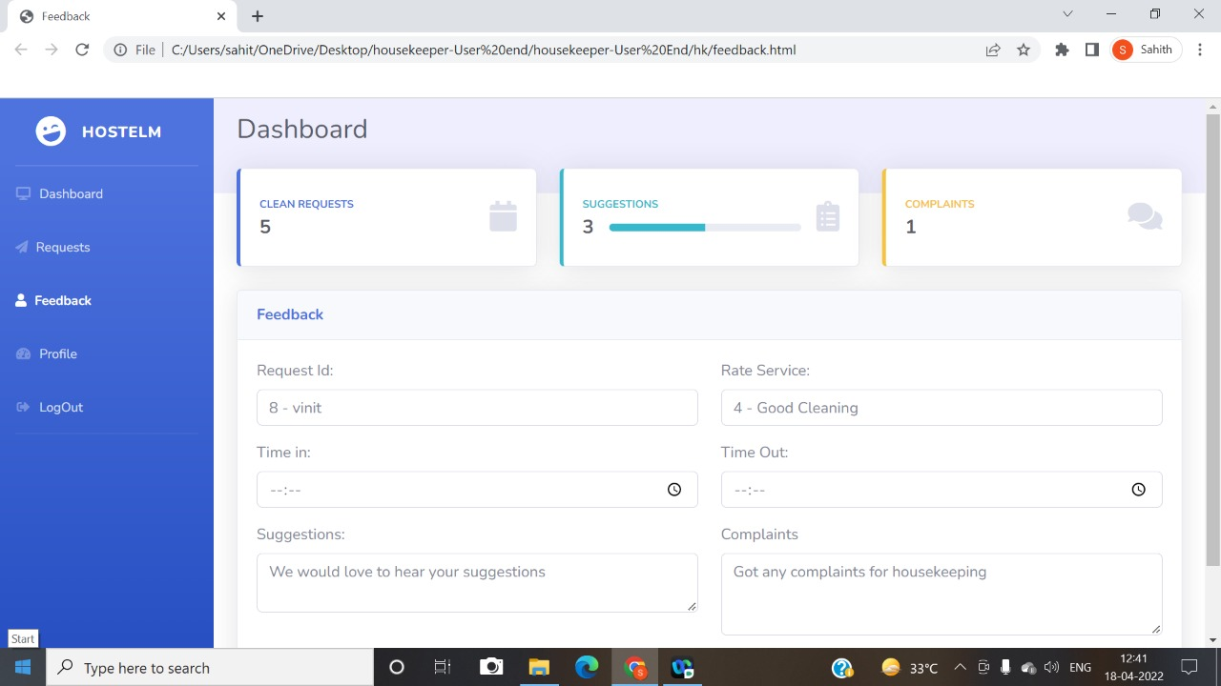
User Feedback:

Slide 22
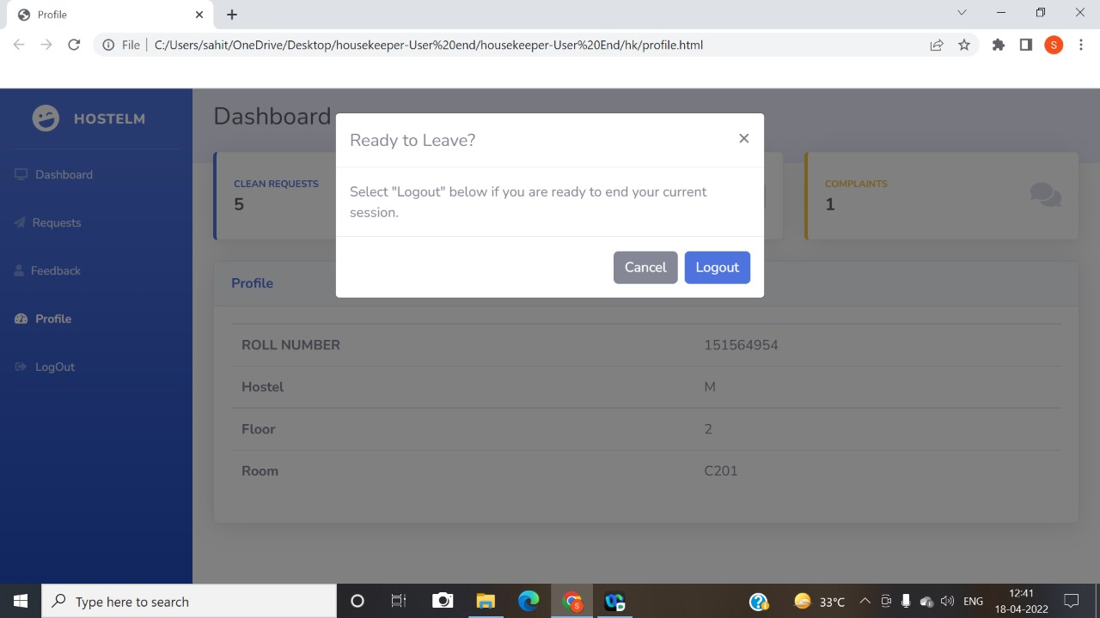
User Logout

Slide 23


